Slide 2
WELCOME
IT Company is most trusted technology solution experts,
providing IT Services and Solutions for businesses to grow online.
COMPANY
PROFILE

Slide 3
WHO WE ARE?
Our corporate culture is characterized by our pursuit to bring the best
& most innovative solutions to our customers.

Slide 4
WHAT WE ARE?
We are the most trusted technology
solution experts, providing IT Services
& Solutions for businesses to grow online.

Slide 5
WHAT WE DO?
We provide a wide range of IT Solution, Web Design,
Graphic Design, App Development, SMS Gateway,
Cloud Hosting, IT support & much more. We work in
close cooperation with our customers to improve
their businesses.
HOSTING
GET POWER & CONTROL
MAKE SURE YOUR DATA IS SAFE & PRIVATE!
First Class Data Center Physical Hardware Servers Available RU Co-lo space is available
Complete Isolation and Protection
DESIGN
We create each new design based on your input on how you would like to portray your brand
DEVELOPMENT
Custom Application Development Services to take your business to a whole new level and make it easy for you to attract more customers
SERVICES
Host your own SMS Gateway
with IT Company and send unlimited SMS from your own brand

Slide 6
BUSINESS
IDEA
We are Australia’s most trusted technology experts, providing IT Services and Solutions for your business to grow online.

Slide 7
OUR
VISION
WE PROVIDE THE
QUALITY IT SOLUTIONS
Our vision is to offer premier IT business services and innovative technology solutions to our customers.

Slide 8
OUR
CORE
VALUE
CUSTOMER FOCUS​
We constantly strive to exceed our customers’ expectations & enable them to excel in their business
INNOVATION
We shape the future by creating innovative solutions throughout our operations
FAIR PLAY
We conduct business in​ a sustainable and ​responsible manner
PASSION TO WIN
We are passionate for making our company ​Successful​

Slide 9
CLOUD
SERVICES
WEB HOSTING
FTP HOSTING
GMAIL HOSTING
BUSINESS CONCEPT​
Secure Storage and Management​
Scalability and Sustainability​
Virtualization and Dynamic​ solutions
Premium brand​
Direct sales​
Value-adding products and ​Cost effective services
CUSTOMER GROUPS​
Service Providers​
Educational Institutes​
Law Firms​
Consulting Firms​
Online Stores/businesses​
Sole Traders and other businesses
EMAIL HOSTING
CLOUD STORAGE
OFFICE 365
VIRTUAL SERVICE
SINGLE SIGN ON
KEY SUCCESS FACTORS​
Adding Capacity on demand​
World-class service and distribution network​
Ability to develop new apps faster​
Cost effective (Cutting IT Cost)​
Growth in Australia & Asia​

Slide 10
WEBSITES PROFESSIONAL
DESIGN SERVICES
WEBSITE DESIGING
WEBSITE BUILDER
LOGO DESIGN
BUSINESS CONCEPT​
Benefit from the best business model
Foster innovation with proven methodology​
Impressive Website and Mobile Friendly design​
Powerful & Easy website Building
Virtualization and Dynamic solution​
Customized websites according to the requirements of our clients​
User Friendly​
Cost effective
CUSTOMER GROUPS​
From small business to big organisations-
We serve​
Educational Institutes​
Government
ONLINE STORE
EBAY STORE
WEB
MAINTENANCE
CONTENT
MANAGEMENT
SYSTEM
KEY SUCCESS FACTORS​
Supreme quality products and services​
Competitive Prices
Highly experienced Teams and technical experts available 24/7​
High growth rate and opportunities for Business growth​
Corporate
Video
Production​

Slide 11
IT
SERVICES
WEB
APPS
MOBILE
APPS
DESKTOP
APPS
BUSINESS CONCEPT​
Innovative applications development​
Efficient, user friendly and customized desktop
applications​
SMS through your branded website​
Low cost bundle of secure SMS can be sent to
clients, employees and others.​
Gives competitive Edge
CUSTOMER GROUPS​
All small, medium and big organisations​
Retail Outlets​
Consultancy Firms​
Educational Institutes​
Government and tax authorities
SQL
SERVICES
SMS GATEWAY
FREE WEB
&
EMAIL TO SMS​
SHAREPOINT
DEVELOPMENT​
POINT OF
SALE
KEY SUCCESS FACTORS​
In-house projects like POS and SMS Gateway​
Competitive Price​
Android, iPhone and Windows compatible apps​
Team of highly experienced and technical experts
available 24/7

Slide 12
IT
SOLUTIONS
INTERNET
MARKETING
EMAIL
NEWSLETTER
BUSINESS
AUTOMATION
BUSINESS CONCEPT​
Best link building and SEO services​
Create & Send Bulk HTML email campaigns &
online Surveys​
Stay Connected & productive all time anywhere​
Business Automated Solutions​
Design, develop & deliver IT Solutions​
Keep sensitive information secure across internet​
CUSTOMER GROUPS​
Research Firms​
Marketing Firms​
Consultancy Firms​
Educational Institutes​
Government and tax authorities​
All small, medium and large firms
IT
OUTSOURCING
MICROSOFT
DYNAMIC CRM​
NETWORK
MONITORING​
EXCHANGE
ONLINE
PROTECTION​
KEY SUCCESS FACTORS​
Feasible for all the groups​
Secure and manage businesses information online​
Online Marketing
SSL
CERTIFICATES​

Slide 13
INTERNAL
PROJECTS
c
​
​
​
v

Slide 14
SMS GATEWAY
BUSINESS CONCEPT​
Secure & quick messaging becomes easier
Productive services that emphasize latest methods for quick communication.
Get rid of old communication methods within and outside your organization.
Makes communication easier & faster through SMS Gateway.
Outstanding SMS services for you to flourish your business instantly.
Can send billing and invoicing details to customers through SMS.
Target Market
Expand in emerging markets
New products / time to market
One of the best SMS Gateway service provider in Australia with cost benefits. that makes communication easier and faster. Save paper cost and go green. Unlimited SMS in One Go.
Emphasize on secure messaging and delivery of SMS in bundles at very low cost and smooth service.

Slide 15
smc.net.au
CLIENT BASE

Slide 16
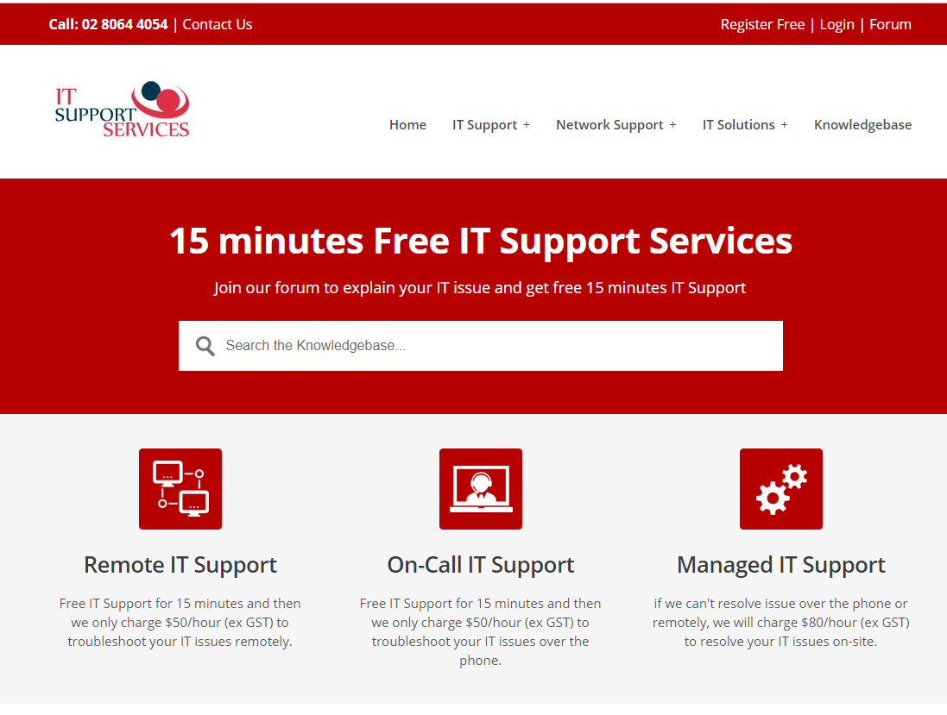
IT SUPPORT
SERVICES

Slide 17
OPPORTUNITIES
For Continued Growth
Emerging online markets
Increased wealth/demographics
Increased focus on innovative IT Solutions to meet competition
Industrial innovation
Higher acceptance rate among customers
Expansion possibilities beyond our premium segments

Slide 18
TEAM OF
EXPERTS

Slide 19
PROFESSIONAL
IT SERVICES
IT Company has 15-years-old history. We are most trusted technology solution experts, providing IT Services & Solutions for businesses to grow online.

Slide 20
WHY THE
BUSINESS
IS BEING STARTED?
We, at IT Company, love to support small businesses, and our digital marketing services will take you to the next level. We have extremely professional and dedicated teams. We know how to put our efforts into what it takes and how to make it happen!

Slide 21
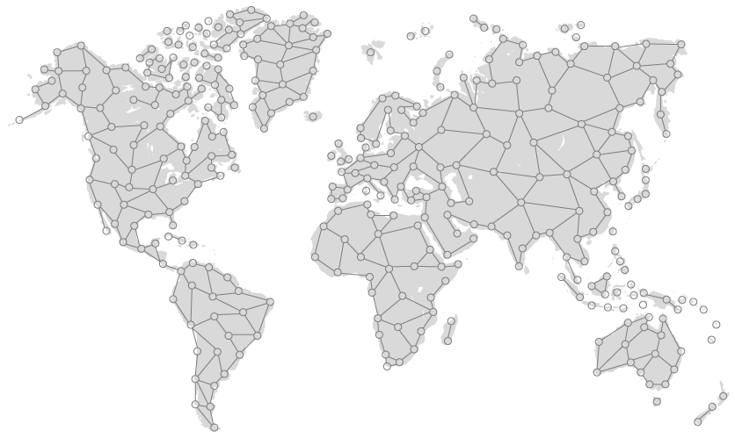
CONTACT IT COMPANY
GLOBAL NETWORK

Slide 22
HOW TO CONNECT WITH
IT COMPANY
Our IT Company incorporates a fully managed customer panel and highlights the services on a global company website, which is live and can be accessed simply by visiting www.itcompany.com.au. You can also reach us by simply writing an email to one of the provided e-mail addresses.
SALES
sales@itcompany.services
SUPPORT
support@itcompany.services
INFO
Info@itcompany.services
SOCIAL MEDIA

